Slide 1


How to search on Google maps
Anna Pechina

Slide 2
How to find all local branches?
General idea: search for local branches on Google maps
Problems:
One google maps request gives maximum 60 results
Google Maps API is not free
Solution:
Divide the search region into small region where we do not expect more than 60 results
Search in them in a smart way to keep the costs in 200 eur that are given for free.

Slide 3
Google Maps API requests we need
Find Place – takes text as an input and returns one place. It is possible to set so-called location bias to search around a certain point. Free is you return only place_id.
Text Search – takes text as an input and returns up to 60 results. For this request it is also possible to set location bias. Costs 0.04 per request.
Place Details – takes place_id as an input and returns information about the place. Costs 0.017 per request.
To use them in python we use googlemaps library, where corresponding functions are called find_place, places and place.

Slide 4
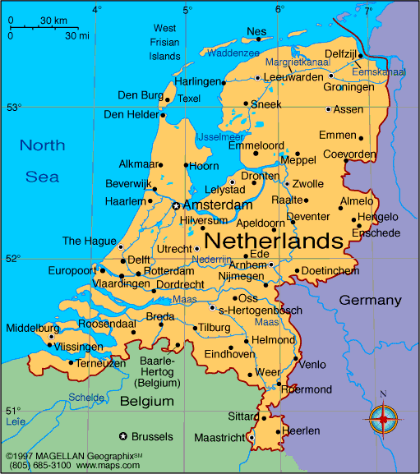
Divide the country in regions
STEP
Step is defined by yourself.
Longitude step
Computed by function long_step to be the same length in kilometers as STEP

Slide 5
And do the search in each of them
Unfortunately, Google maps can only search in circles, not squares. So we do the following:
We go through all the orange points,
draw a circle around each of them
and then search within the circle.

Slide 6
General plan of search in each circle
1. Identify countries in the circle by looking at countries at four points on the border
2. Define the search words for this circle depending on countries language and religion
3. Check whether there are any search results in this circle
4. If yes, do text search for this circle

Slide 7
Identify countries in the circle
Function list_of_countries.
Go through four blue points
Find the country in each point using which_country function. Function which_country uses geopy library to find the country.
To save some time, we save result for each point in geopy_dict and use it if we need this point again.

Slide 8
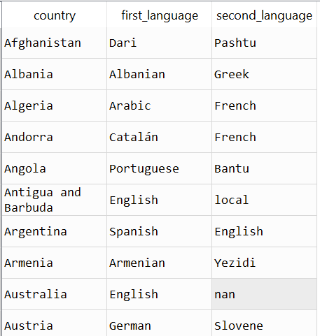
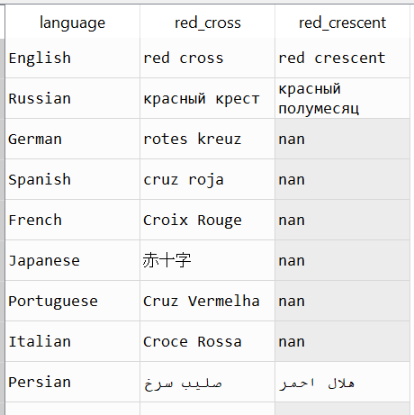
Define search words for each country
languages
Function search_words
Check if the country is a muslim country and we have to search for Red Crescent
Find the languages for this countries using search_language function.
search_language function looks at 2 most popular languages in the country and take those that are among 38 most popular in internet languages. If there are no such languages, use English.
Then we take the relevant translations from the table translations.
translations

Slide 9
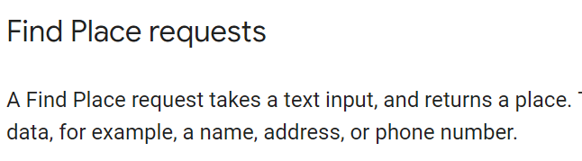

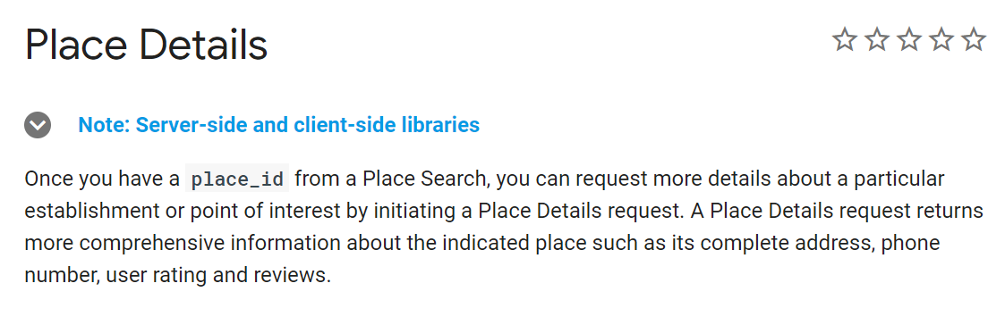
Do the first search to eliminate some circles
Do the free search in the circle with search_for function using free version of Find Place request
Look at the places that were found more than once, they are suspicious. For them do Place Details request to find their real coordinates. Filter out circles where the found place was outside of the circle.
Find Place request is free if it returns only place_id
Place Details costs 0.017 eur per request.
Takes as an input place_id and returns some information, including coordinates.

Slide 10
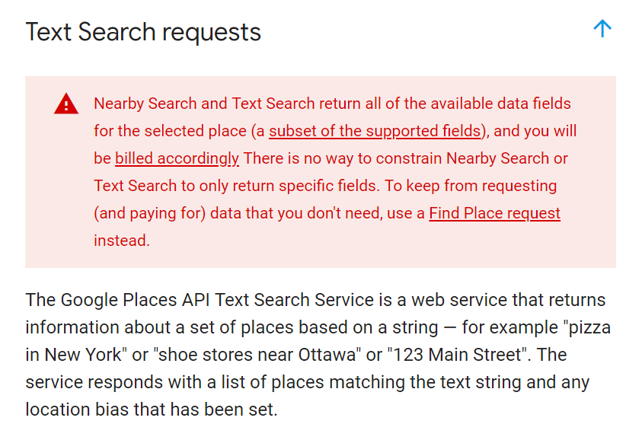
Do extensive search in survived circles
Function text_search
Go through all survived pairs of point + search word and do Text Search request for them using text_search function. Note that one request returns 20 results and we should go through 3 pages to get all 60 results.
Delete duplicate results.
Use Place Detail request again to get extensive information such as phone or website.
Text Search costs 0.04 eur per request.

Slide 11
General plan of search in each circle
1. Identify countries in the circle by looking at countries at four points on the border
2. Define the search words for this circle depending on countries language and religion
3. Check whether there are any search results in this circle
4. If yes, do text search for this circle

